Slide 1


A2 level 05 Week 03
Friday’s Speaking Session
Topic of the Session:
Home Sweet Home

Slide 2


PART 1: Warm up YOUR tongue
“Try to do the following dialogue with your teacher and correct your pronunciation mistakes along the way.”
This exercise corrects your pronunciation and improves your reading skills

Slide 3
Dialogue (Mounir & The teacher)
(teacher): Hi good morning, (Student’s name). How are you?
Mounir (Student): Hi good morning, teacher. I am fine. Thank you. And you?
(teacher): I am fine, too. Thanks. Please, tell me, (student’s name) ... How do you manage to live in a big house?
Mounir (Student): I think you are wrong, teacher. Actually, we don’t have a big house. We rent an apartment. I mean, We can afford to buy a house. We just don’t see a reason.
(teacher): How is that? Can you explain?
Mounir (Student): We -the parents- both work almost all day. So we wouldn’t have time to manage a big house. Also, we believe an apartment is much safer for a working couple.
Any pronunciation error is corrected by the teacher instantly!

Slide 4
Dialogue (Mounir & The teacher)
(teacher): I agree with you. But how about the other common issues of the apartment like problems with the elevator, the parking lot and the noisy neighbors??!
Mounir (Student): First of all, we live on the 1st floor so we never use the elevator. Second, the building has a vast parking lot so there is always a parking space for everyone.
Mounir (Student): Also, I have some really good neighbors. We get along very well.
(teacher): How about the noise though?
Mounir (Student): Not a problem either. The building walls and roofs are sound-proof. So you can’t hear anything no matter how noisy it is.
(teacher): That sounds great!! Thank you so much (student’s name) for sharing this much.
Mounir (Student): The same here. You are always welcome teacher!
Any pronunciation error is corrected by the teacher instantly!

Slide 5

PART 2: Practical review
“Look at the following pictures and answer the questions asked by the teacher.”
This exercise helps you to member the vocabulary you learnt during the week

Slide 6
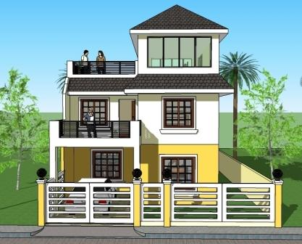
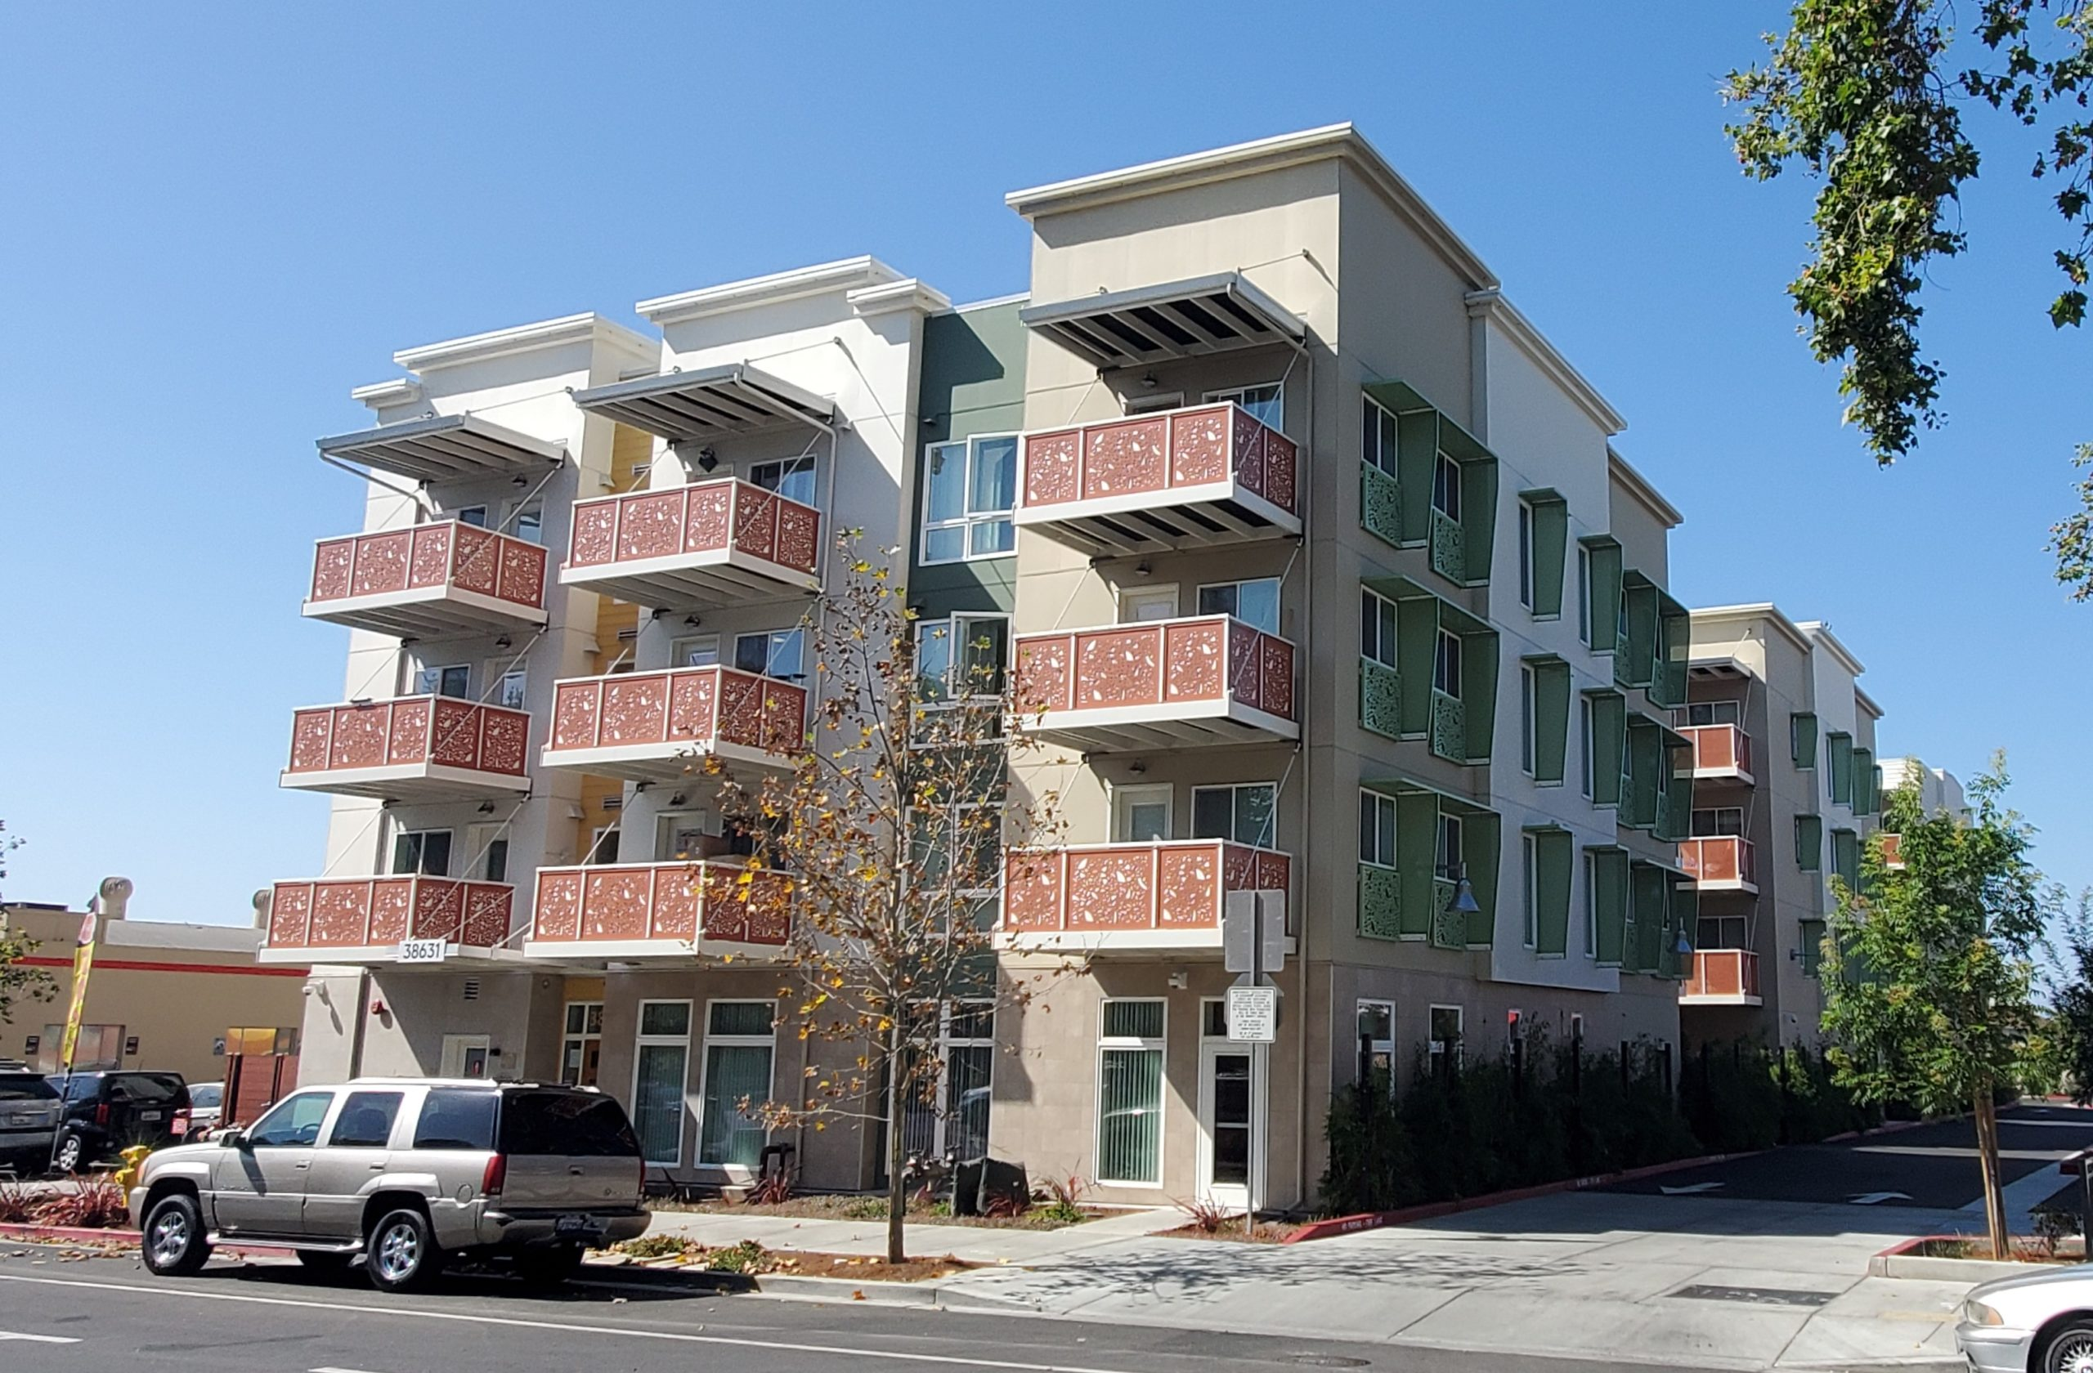
-A-
Possible questions:
Take a look at the house on –Picture A- ...
Is it a 2-storey or a 3-storey house?
Does it have a garage?
If not, where does the house owner park his car?
Does it have a balcony?
Does it have a courtyard?
Take a look at the circled apartment on –Picture B- ...
On floor is it?
Is there a balcony in that apartment?
Is there a parking lot near by? (based on the picture)
-b-
If you don’t understand the question, ask the teacher to clarify it further!

Slide 7
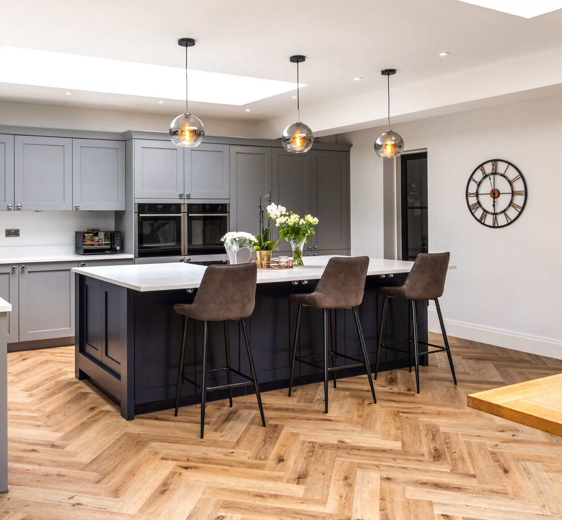
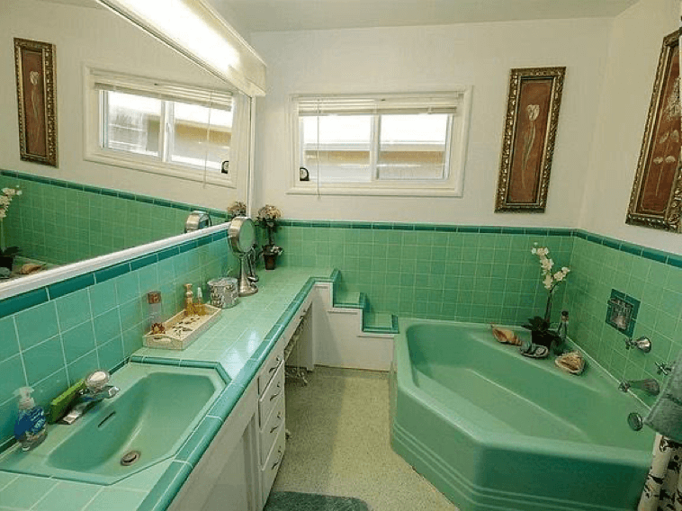
-A-
Possible questions:
Take a look at –Picture A- ...
Is this a bedroom?
What is this?
What do we do in this area?
Is the one on the picture MODERN or OLD-FASHIONED?
Take a look at –Picture B- ...
Is this a balcony?
What is this?
Is the one on the picture MODERN or OLD-FASHIONED?
What do you prefer? Modern or Old-fashioned?
-b-
If you don’t understand the question, ask the teacher to clarify it further!

Slide 8
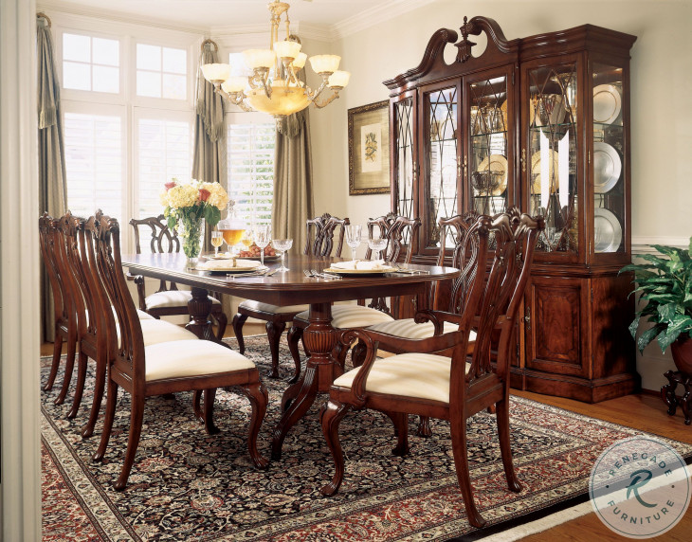
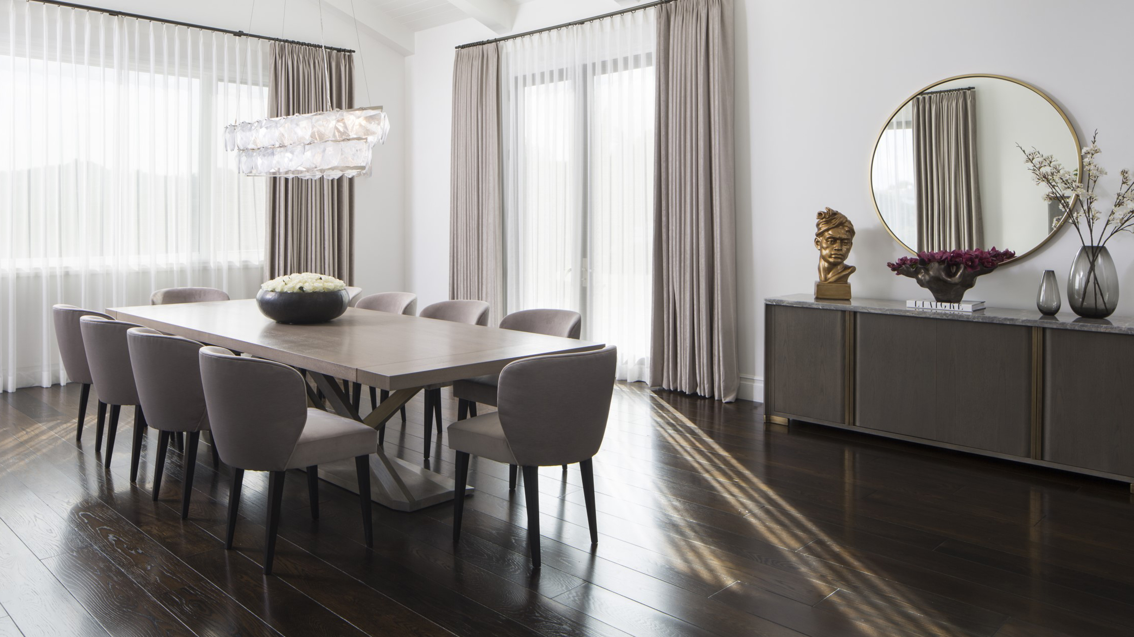
-A-
Possible questions:
Take a look at the following pictures ...
Do they represent the same room?
Are these living rooms?
If not, what are they?
Do we find such a room in every house?
Is it a house necessity in your opinion? Why? Or why not?
What is the difference between the two A and B?
Which one did you like the most? And can you tell us why?
-b-
If you don’t understand the question, ask the teacher to clarify it further!

Slide 9
-A-
Possible questions:
Take a look at the following pictures ...
Do they represent the same room?
Are these living rooms?
If not, what are they?
Do we find such a room in every house?
Is it a house necessity in your opinion? Why? Or why not?
What is the difference between the two A and B?
Which one did you like the most? And can you tell us why?
-b-
If you don’t understand the question, ask the teacher to clarify it further!

Slide 10
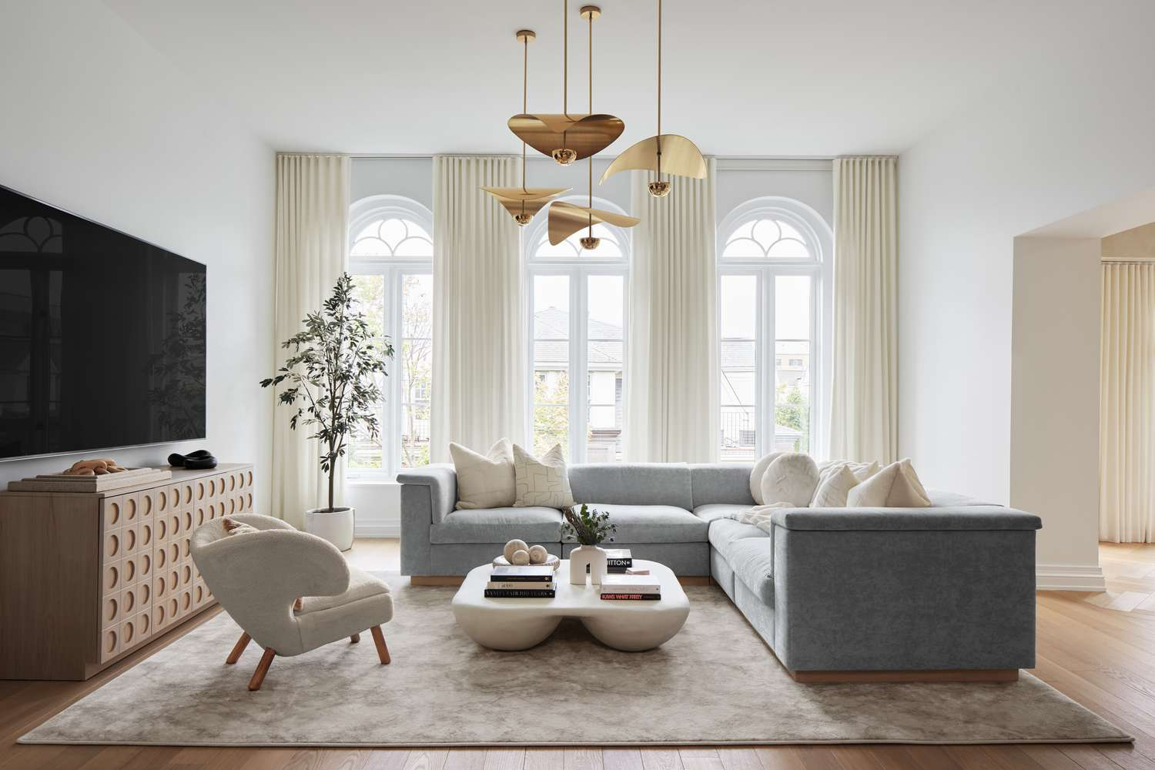
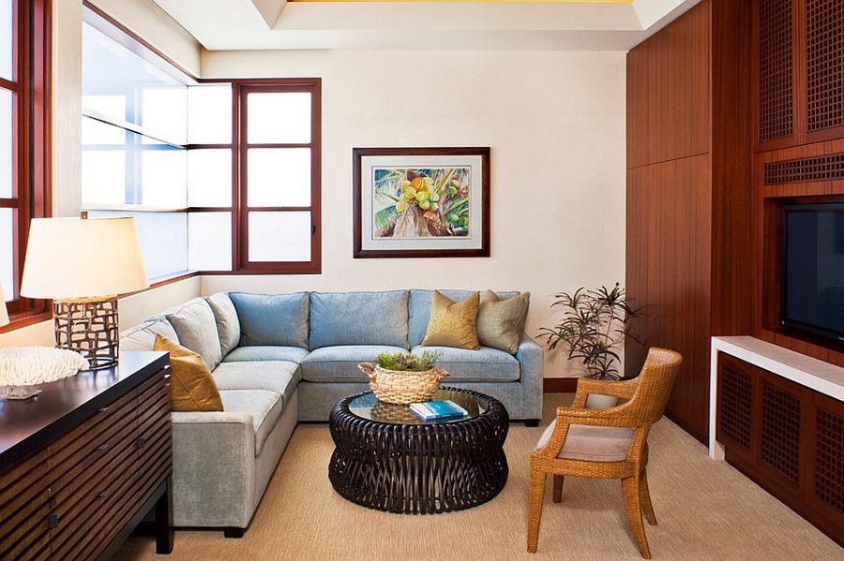
-A-
Possible questions:
Take a look at the following pictures ...
Do they represent the same room?
Are these dining rooms?
If not, what are they?
Do we find such a room in every house?
Is it a house necessity in your opinion? Why? Or why not?
What is the difference between the two A and B?
Which one did you like the most? And can you tell us why?
-b-
If you don’t understand the question, ask the teacher to clarify it further!

Slide 11
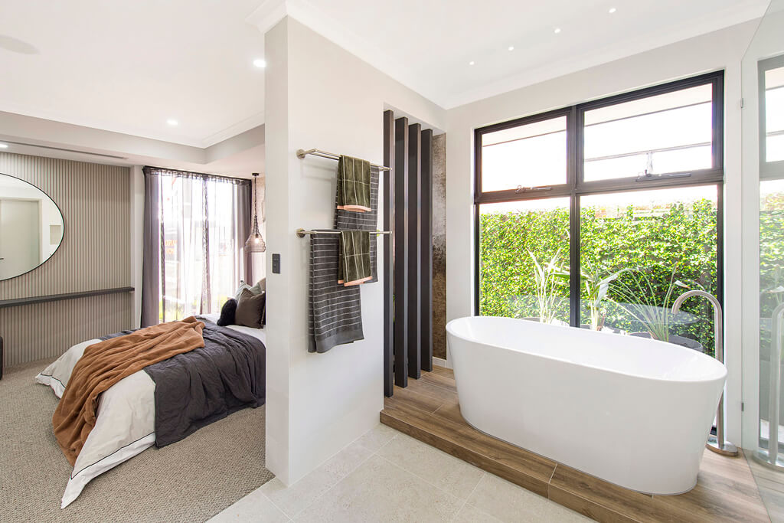
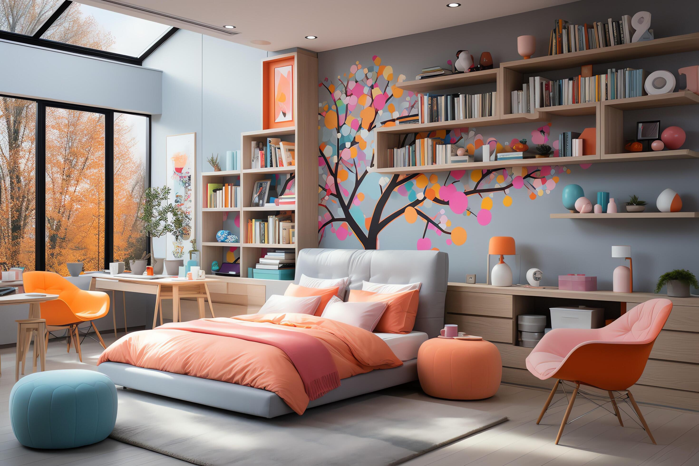
-A-
Possible questions:
Take a look at Picture –A- ...
What room is it?
Does it have a bathroom?
Does it always come with a bathroom?
Is it modern or old-fashioned?
Is it the same as the one on Picture –B-?
What is the difference between the two A and B?
Does the one on Picture –B- come with a bathroom, too?
-b-
If you don’t understand the question, ask the teacher to clarify it further!

Slide 12
-A-
Possible questions:
Can you name these picture from A to?
Does it have a bathroom?
Does it always come with a bathroom?
Is it modern or old-fashioned?
Is it the same as the one on Picture –B-?
What is the difference between the two A and B?
Does the one on Picture –B- come with a bathroom, too?
-b-
If you don’t understand the question, ask the teacher to clarify it further!

Slide 13
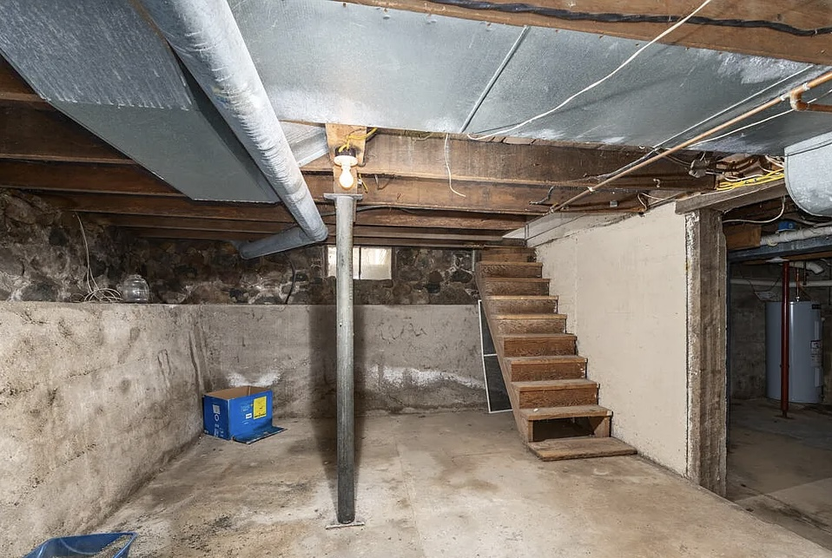
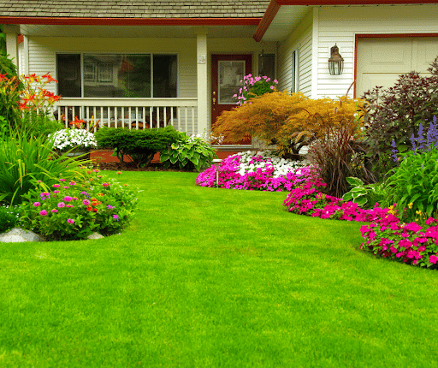
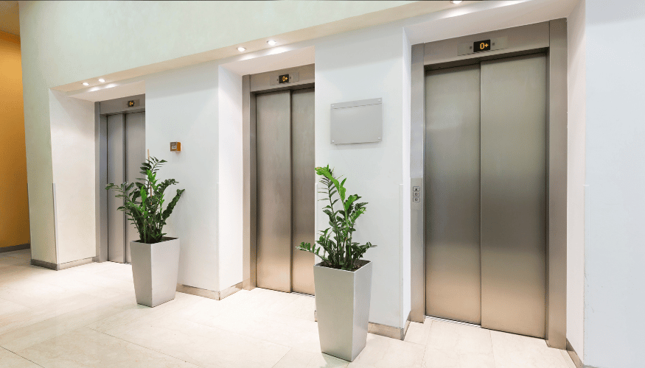
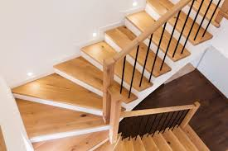
-A-
Possible questions:
Can you name these picture from A to D?
Can we find –A- in an apartment?
Can we find –B- in an apartment?
Can we find C and D in a house?
-b-
-C-
-D-
If you don’t understand the question, ask the teacher to clarify it further!

Slide 14
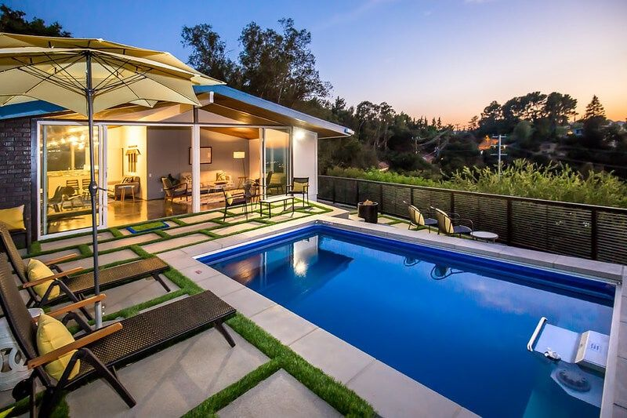
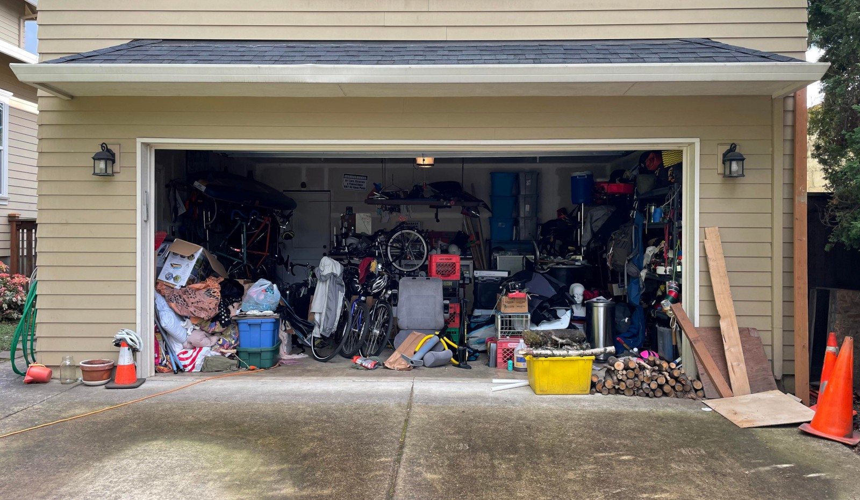
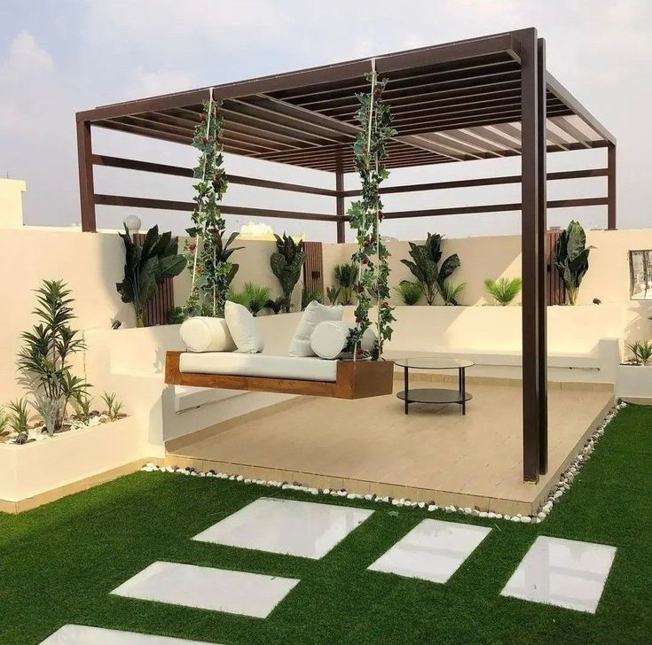
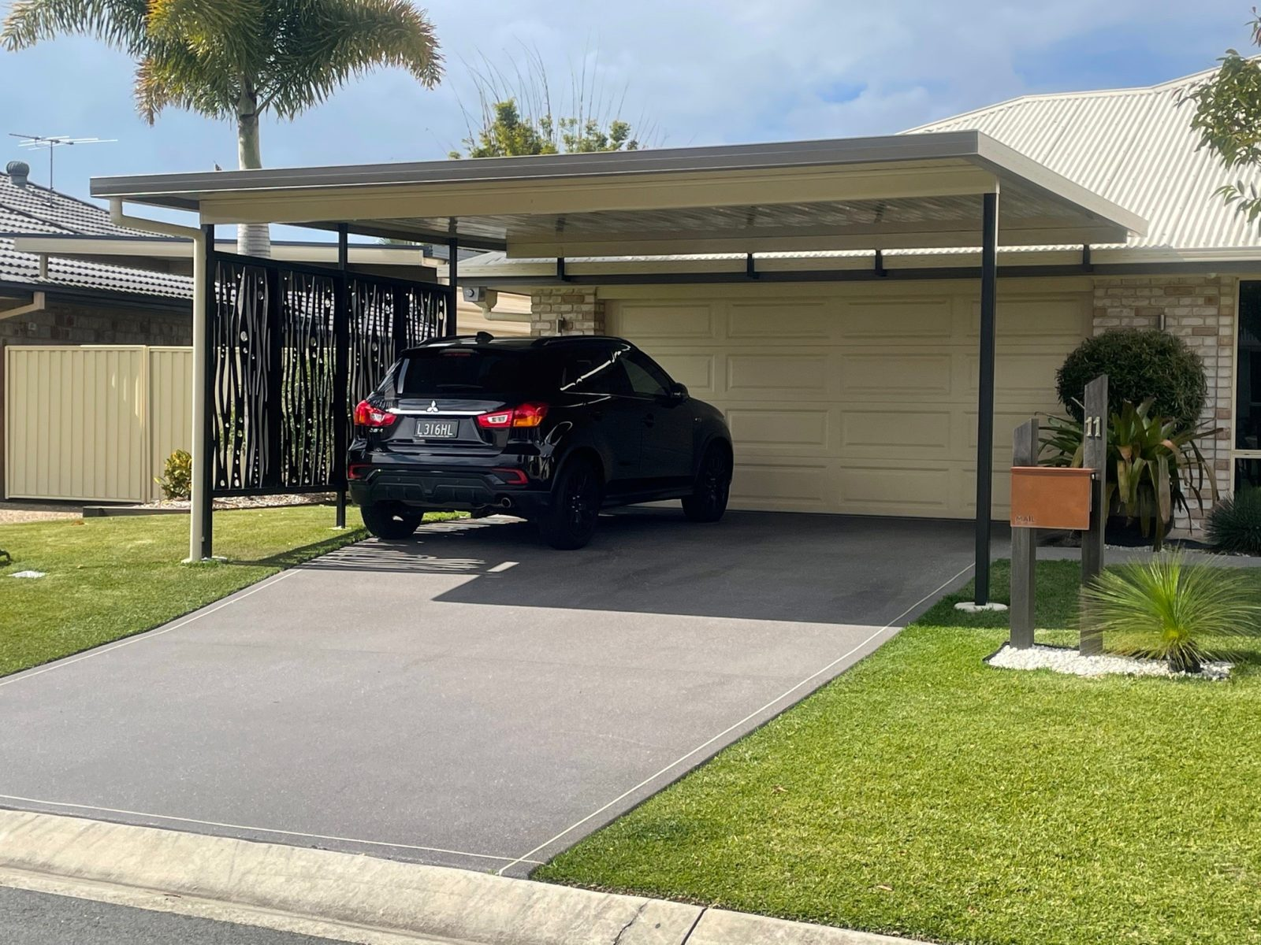
-A-
Possible questions:
Can you name these picture from A to D?
Can you mention which one is found in the apartment and which one can only found in a house?
-b-
-C-
-D-
If you don’t understand the question, ask the teacher to clarify it further!

Slide 15

PART 3: Direct Conversation
During your conversation with the teacher, you may expect some of the following questions:
Do you live with a big or small family?
Do you live in a house or an apartment?
If a house, how many floors are there?
How many rooms are there in each floor?
Is it modern or old fashioned
Do you have a basement?
Do you have a terrace?
8. If it is an apartment, on which floor is it?
9. How many rooms are there?
10. Do you use the elevator or the stairs most often?
11. Do you have a terrace or a balcony?
12. Are your neighbors noisy?
13. How do you like your house/apartment? And what issues are you facing there?
It’s time to SPEAK freely without fear or hesitation ... You are READY!

Slide 16

PART 4: Homework (oQ)
Task of the week: Read the following question and answer based on your own opinion. (short answers aren’t accepted!!!)
OQ: If you could choose ... Would you choose to lie in an apartment or in a big house? And why?
Explain and justify your answer!
This homework is to do your research and learn new vocabulary in the process

Slide 17
IMPORTANT NOTES
Any pronunciation error is corrected by the teacher instantly!

